Slide 1
Hotel Booking
Danny, Allan, Thanushan

Slide 2






Slide 3
Project Description
Store Hotel information in Database
Present robust but simple interface for stored information
Allow clients to use as traditional Hotel booking site

Slide 4
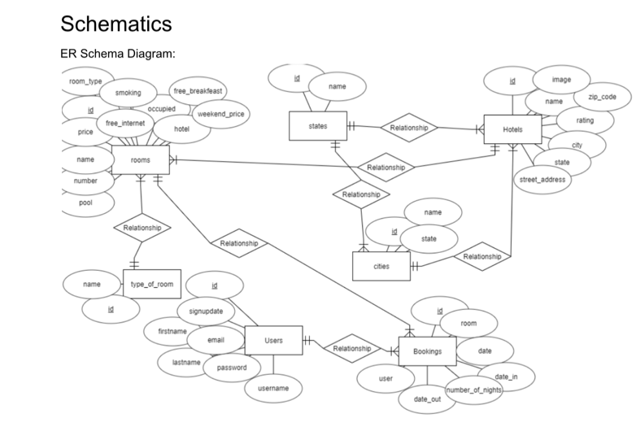
ER Schema Diagram

Slide 5
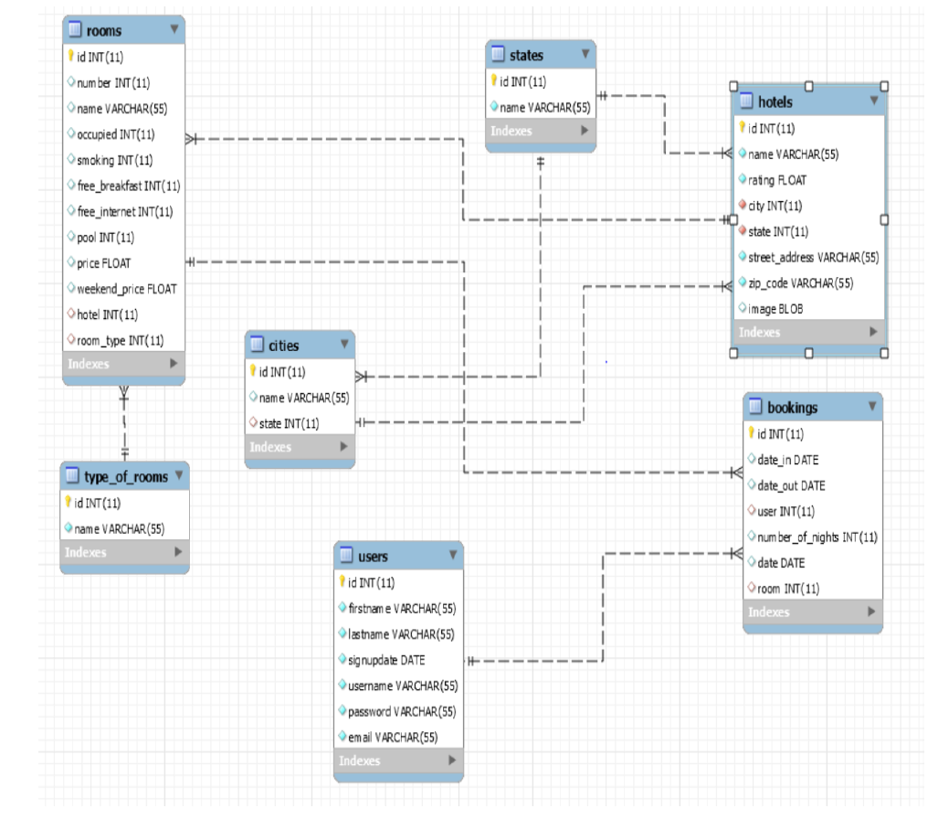

Slide 6
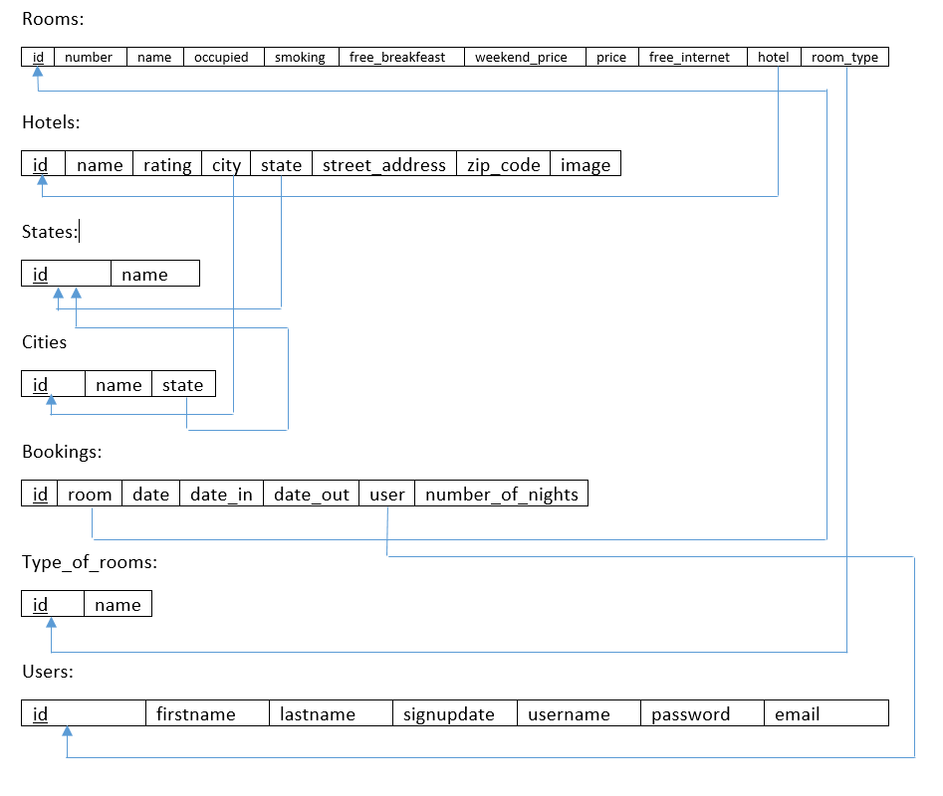
Relational Schema Diagram

Slide 7
DEMO

